Slide 1
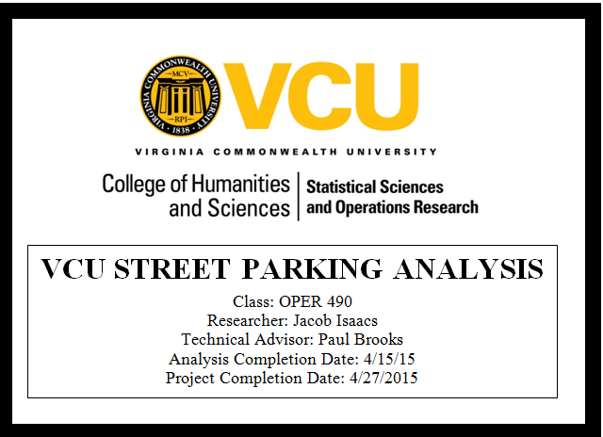

Slide 2
Discussion Summary
Project Goal: To effectively analyze and simulate street parking around VCU campus.
Similar Studies
Methods
Simulation Creation
Simulation Results Summary
Final Analysis
Conclusion
Questions?

Slide 3
Similar Studies
Based on 11 Studies
What Parking Analysis Studies attempt to achieve:
Good size for Parking areas based on constraints
Proper Street Parking Regulations
Minimizing Costs of Parking Areas using meters
Proper Design to reduce traffic flow

Slide 4
Donald Shoup and No Vacancy
Donald Shoup – Professor in Urban Planning
Cruising for Parking
Study explains reasons why parking is important
No Vacancy
45% of total traffic was cruising for parking in their area
94% average curb saturation

Slide 5
Methods
Choosing The Areas
Data Collection Evolution
Calculating Inter-Arrival Rates
Summary Statistics

Slide 6
Choosing The Areas
Parking Restrictions?
Meter
Time Signs
Hourly
No Park
No Restriction
Good visibility
Commuter Student Spots
Decision: 4 Unrestricted, 2 Restricted

Slide 7
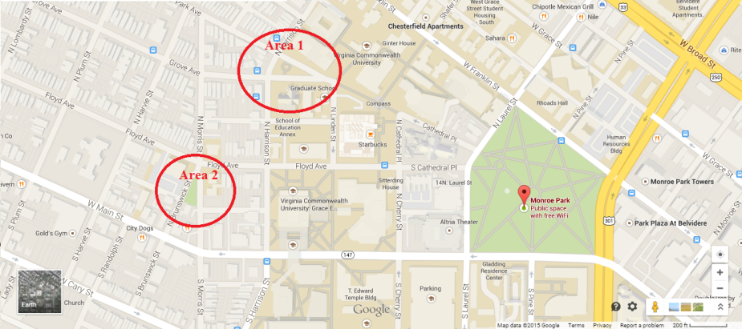
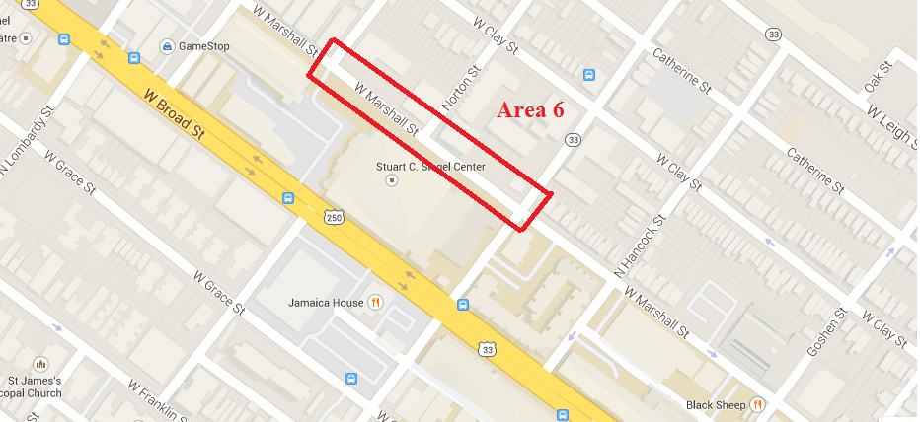
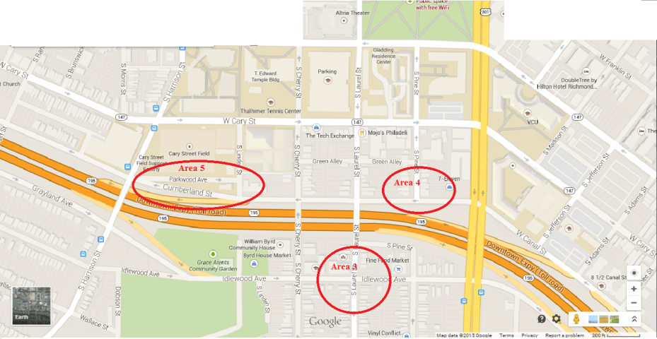
The Areas

Slide 8
Data Collection
Continuous Stop Watch vs. Non-continuous
Information needed for simulation
Total number of spots
Number of spots at time 0
Times: car arrives, car parks, parked car leaves, car leaves
Data Collection Evolution
Why it Happened
Effective recording of the speed of incoming cars.
Human Ability
4-6 Entries every 10 seconds

Slide 9
Data Collection Evolution
Evolution 1
Evolution 2
Evolution 3

Slide 10
Inter-Arrival Rate Calculation
First and Second Stage Evolution = Simple
Third Stage Evolution = Complex
Simple
Inter-Arrival = Next Time – Current Time
Complex
Simple / number of cars = Average inter times
Current Time + Average Inter times until = Next Time
VBA Code and Written Notation

Slide 11
Written Notation

Slide 12
Inter-Arrival Rate Calc Cont.
The Power of @Risk Software
Different Distributions
Rating Criterion
Formatting issues in Excel
hh:mm:ss not easily recognized
Change to value than multiply by 60 and 24 to get seconds

Slide 13
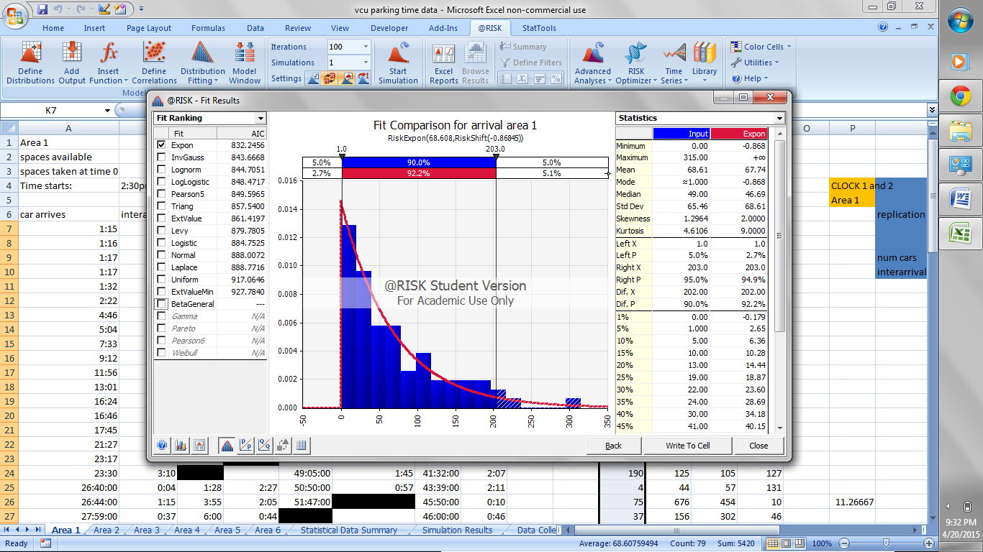

The Power of @Risk
6 Distribution Tests
18 Distributions

Slide 14
Summary Statistics

Slide 15
Simulation Creation
Simulation Software based on queueing theory.
Arena
Qmms
MatLab
VBA
Siemens PLM Software
Java
http://web2.uwindsor.ca/math/hlynka/qsoft.html
List of 73 different queueing theory software packages

Slide 16
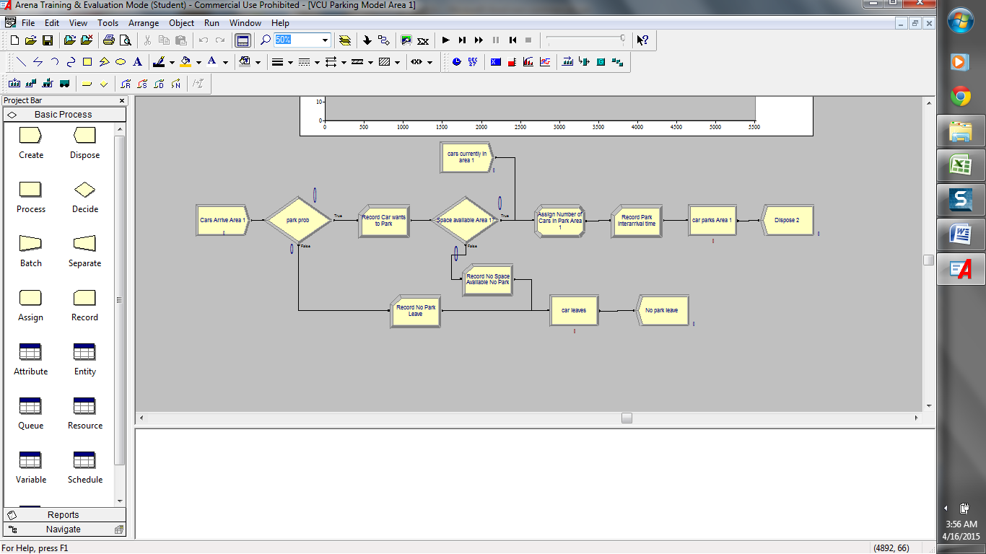
Simulation Model Logic

Slide 17
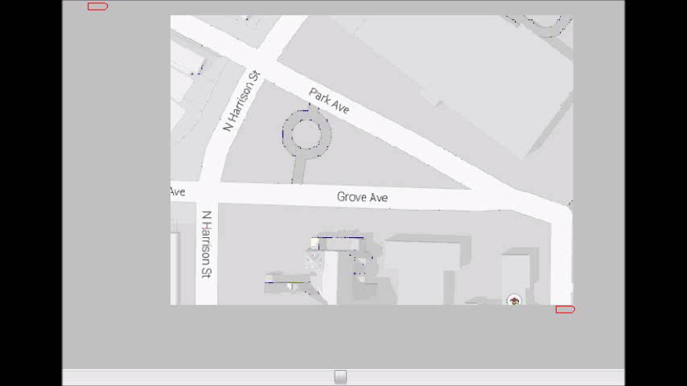

Slide 18
Simulation Results Summary

Slide 19
Final Analysis

Slide 20
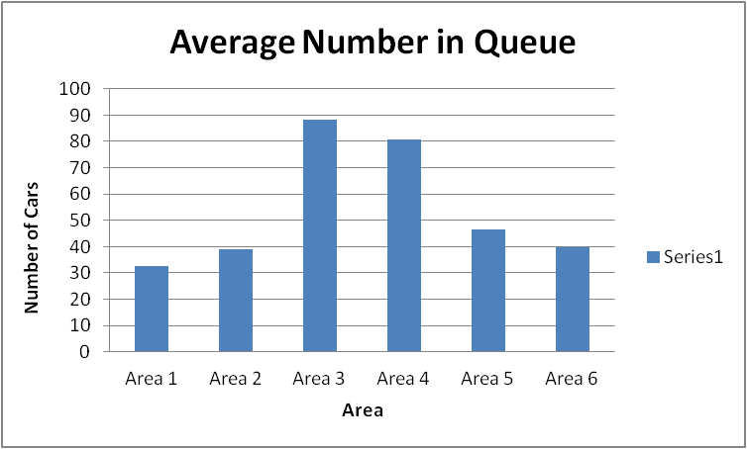
Number in Queue Comparison

Slide 21
Regulated Vs. Un-Regulated
4 UNREGULATED AREAS
Number of Replications | 50
replication length | 2909.5 |  | total data collection time:
 | Average | Half Width | 11638 seconds
Car wishes to park | 9.185 | 0.79 | 3 hours 13 minutes 58 seconds
No space available leave | 0.855 | 0.3725 | Average System Time
No Park Leave | 175.355 | 2.92 | 48 minutes 29 seconds
Parking Area Utilization | 1 | 0 | park prob based on stat sum
Time spent in Parking Queue | 1274.465 | 51.065 | 9.66%
Average time in system | 220.2538 | 19.845
Graph of WIP in queue for park process: | 50 Reps

Slide 22
Room For Improvements
Park probability maybe larger. During the study illegal and no parking regulated area were accounted for which can skew available spots, and parking probability.
Data Collection:
Smaller area = more accurate results
Accounting for a few spots during a time interval
Account for each spot rather than all of the spots and creating an average for the area.
Collect during different times of day over several weeks
Simulate based on parking spot rather than parking area

Slide 23
Conclusive Thoughts
This Project creates a basis for a more in-depth parking study, and describes averages in different areas around VCU.
Cars are parking approx every 4 minutes, and they are arriving approx every 49 seconds.
Street Parking in the selected areas may not be that terrible since parking happens fairly quickly.
An increase in free parking lots will reduce the amount of cruising.

Slide 24
QUESTIONS

